Slide 1
AngularJS Tutorial 2015. 7.
http://www.w3schools.com/angular/
중부대학교 이병천 교수

Slide 2
AngularJS란?
기존의 HTML에 새로운 속성을 사용할 수 있도록 만든 자바스크립트 프레임워크
Single Page Application (SPA) 개발에 유용한 도구
2009년에 구글의 Misko Hevery가 개발 시작
2012년에 AngularJS v1.0 발표
Misko Hevery
http://misko.hevery.com/

Slide 3
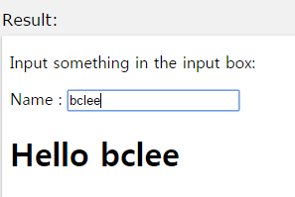
예제
첫번째 예제
<!DOCTYPE html>
<html>
<script src= "http://ajax.googleapis.com/ajax/libs/angularjs/1.3.14/angular.min.js"> </script>
<body>
<div ng-app="">
<p>Input something in the input box:</p>
<p>Name : <input type="text" ng-model="name" placeholder="Enter name here"></p>
<h1>Hello {{name}}</h1>
</div>
</body>
</html>

Slide 4
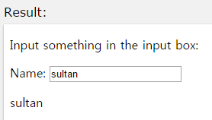
용어
지시자(Directives): ng-directives
ng-app : AngularJS 어플리케이션을 정의
ng-model : input, select, textarea 등의 HTML 요소의 값을 어플리케이션 데이터로 사용할 수 있도록 bind
ng-bind : 어플리케이션 데이터를 HTML View로 bind
ng-init : 어플리케이션의 변수를 초기화
ng-controller : 콘트롤러를 정의
<!DOCTYPE html>
<html>
<script src= "http://ajax.googleapis.com/ajax/libs/angularjs/1.3.14/angular.min.js"></script>
<body>
<div ng-app="" ng-init="name='sultan'">
<p>Input something in the input box:</p>
<p>Name: <input type="text" ng-model="name"></p>
<p ng-bind="name"></p>
</div>
</body>
</html>

Slide 5
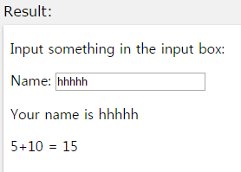
용어
표현식 (Expressions)
AngularJS에서 표현식은 이중괄호로 둘러싸서 표시
<!DOCTYPE html>
<html>
<script src= "http://ajax.googleapis.com/ajax/libs/angularjs/1.3.14/angular.min.js"></script>
<body>
<div ng-app="">
<p>Input something in the input box:</p>
<p>Name: <input type="text" ng-model="name"></p>
<p>Your name is {{name}}</p>
<p>5+10 = {{5+10}} </p>
</div>
</body>
</html>

Slide 6
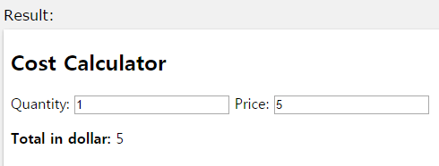
예제
총 금액 계산기
<!DOCTYPE html>
<html>
<script src= "http://ajax.googleapis.com/ajax/libs/angularjs/1.3.14/angular.min.js"></script>
<body>
<div data-ng-app="" data-ng-init="quantity=1;price=5">
<h2>Cost Calculator</h2>
Quantity: <input type="number" ng-model="quantity">
Price: <input type="number" ng-model="price">
<p><b>Total in dollar:</b> {{quantity * price}}</p>
</div>
</body>
</html>

Slide 7
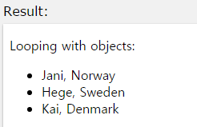
HTML 요소의 반복 표현
Ng-repeat 지시자 이용
<!DOCTYPE html>
<html>
<script src= "http://ajax.googleapis.com/ajax/libs/angularjs/1.3.14/angular.min.js"></script>
<body>
<div ng-app="" ng-init="names=[{name:'Jani',country:'Norway'},{name:'Hege',country:'Sweden'},
{name:'Kai',country:'Denmark'}]">
<p>Looping with objects:</p>
<ul>
<li ng-repeat="x in names">
{{ x.name + ', ' + x.country }}</li>
</ul>
</div>
</body>
</html>

Slide 8
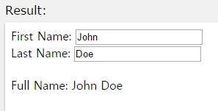
AngularJS 컨트롤러
AngularJS 컨트롤러
<!DOCTYPE html>
<html>
<script src= "http://ajax.googleapis.com/ajax/libs/angularjs/1.3.14/angular.min.js"></script>
<body>
<div ng-app="myApp" ng-controller="personCtrl">
First Name: <input type="text" ng-model="firstName"><br>
Last Name: <input type="text" ng-model="lastName"><br>
<br>
Full Name: {{fullName()}}
</div>
<script>
var app = angular.module('myApp', []);
app.controller('personCtrl', function($scope) {
$scope.firstName = "John";
$scope.lastName = "Doe";
$scope.fullName = function() {
return $scope.firstName + " " + $scope.lastName;
}
});
</script>
</body>
</html>

Slide 9
컨트롤러의 분리 운영
컨트롤러를 외부 파일로 운영하는 방식
어플리케이션의 규모가 커지면 별도로 운영하는 것이 바람직
<!DOCTYPE html>
<html>
<script src= "http://ajax.googleapis.com/ajax/libs/angularjs/1.3.14/angular.min.js"></script>
<body>
<div ng-app="myApp" ng-controller="personCtrl">
First Name: <input type="text" ng-model="firstName"><br>
Last Name: <input type="text" ng-model="lastName"><br>
<br>
Full Name: {{firstName + " " + lastName}}
</div>
<script src="personController.js"></script>
</body>
</html>
// personController.js (외부파일)
var app = angular.module('myApp', []); app.controller('personCtrl', function($scope) { $scope.firstName = "John"; $scope.lastName = "Doe"; $scope.fullName = function() { return $scope.firstName + " " + $scope.lastName; } });

Slide 10
AngularJS 필터
필터 | 설명
currency | 통화 양식으로 표시
filter | 배열에서 주어진 조건과 일치하는 내용을 표시
lowercase | String을 소문자로 표시
orderBy | 주어진 조건으로 정렬
uppercase | String을 대문자로 표시

Slide 11
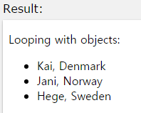
AngularJS 필터
orderBy 필터 사례
<!DOCTYPE html>
<html>
<script src= "http://ajax.googleapis.com/ajax/libs/angularjs/1.3.14/angular.min.js"></script>
<body>
<div ng-app="myApp" ng-controller="namesCtrl">
<p>Looping with objects:</p>
<ul>
<li ng-repeat="x in names | orderBy:'country'">
{{ x.name + ', ' + x.country }}
</li>
</ul>
</div>
<script src="namesController.js"></script>
</body>
</html>

Slide 12
AngularJS 필터
currency 필터 사례
<!DOCTYPE html>
<html>
<script src= "http://ajax.googleapis.com/ajax/libs/angularjs/1.3.14/angular.min.js"></script>
<body>
<div ng-app="myApp" ng-controller="costCtrl">
Quantity: <input type="number" ng-model="quantity">
Price: <input type="number" ng-model="price">
<p>Total = {{ (quantity * price) | currency }}</p>
</div>
<script>
var app = angular.module('myApp', []);
app.controller('costCtrl', function($scope) {
$scope.quantity = 1;
$scope.price = 9.99;
});
</script>
</body>
</html>

Slide 13
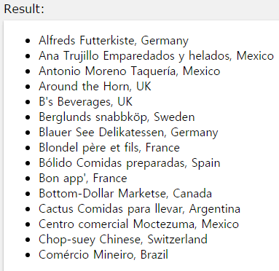
$http를 이용한 원격지 서버 데이터 읽기
AngularJS의 $http는 웹서버로부터 데이터를 읽어올 수 있는 XMLHttpRequest 서비스. $http.get(url) 함수 이용
<!DOCTYPE html>
<html>
<script src= "http://ajax.googleapis.com/ajax/libs/angularjs/1.3.14/angular.min.js"></script>
<body>
<div ng-app="myApp" ng-controller="customersCtrl">
<ul>
<li ng-repeat="x in names">
{{ x.Name + ', ' + x.Country }}
</li>
</ul>
</div>
<script>
var app = angular.module('myApp', []);
app.controller('customersCtrl', function($scope, $http) {
$http.get("http://www.w3schools.com/angular/customers.php")
.success(function (response) {$scope.names = response.records;});
});
</script>
</body>
</html>

Slide 14
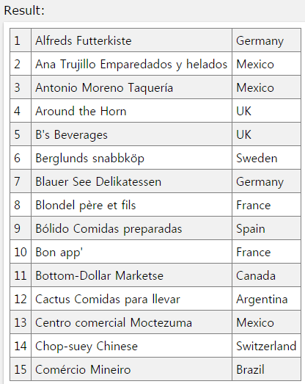
데이터를 테이블로 표시하기
<!DOCTYPE html>
<html>
<style>
table, th , td {
border: 1px solid grey;
border-collapse: collapse;
padding: 5px;
}
table tr:nth-child(odd) {
background-color: #f1f1f1;
}
table tr:nth-child(even) {
background-color: #ffffff;
}
</style>
<script src= "http://ajax.googleapis.com/ajax/libs/angularjs/1.3.14/angular.min.js"></script>
<body>
<div ng-app="myApp" ng-controller="customersCtrl">
<table>
<tr ng-repeat="x in names">
<td>{{ $index + 1 }}</td>
<td>{{ x.Name }}</td>
<td>{{ x.Country }}</td>
</tr>
</table>
</div>
<script>
var app = angular.module('myApp', []);
app.controller('customersCtrl', function($scope, $http) {
$http.get("http://www.w3schools.com/angular/customers.php")
.success(function (response) {$scope.names = response.records;});
});
</script>
</body>
</html>

Slide 15
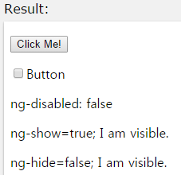
AngularJS HTML DOM
DOM을 제어하는 지시자들
ng-disabled
ng-show
ng-hide
<!DOCTYPE html>
<html>
<script src= "http://ajax.googleapis.com/ajax/libs/angularjs/1.3.14/angular.min.js"></script>
<body>
<div ng-app="" ng-init="mySwitch=true">
<p><button ng-disabled="mySwitch">Click Me!</button></p>
<p><input type="checkbox" ng-model="mySwitch"/>Button</p>
<p>ng-disabled: {{ mySwitch }}</p>
<p ng-show="true">ng-show=true; I am visible.</p>
<p ng-show="false">ng-show=false; I am not visible.</p>
<p ng-hide="true">ng-hide=true; I am not visible.</p>
<p ng-hide="false">ng-hide=false; I am visible.</p>
</div>
</body>
</html>

Slide 16
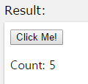
AngularJS Events
이벤트를 다루는 지시자들
ng-click
<!DOCTYPE html>
<html>
<script src= "http://ajax.googleapis.com/ajax/libs/angularjs/1.3.14/angular.min.js"></script>
<body>
<div ng-app="myApp" ng-controller="myCtrl">
<button ng-click="count = count + 1">Click Me!</button>
<p>Count: {{ count }}</p>
</div>
<script>
var app = angular.module('myApp', []);
app.controller('myCtrl', function($scope) {
$scope.count = 0;
});
</script>
</body>
</html>

Slide 17
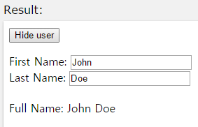
AngularJS Events
<div ng-app="myApp" ng-controller="personCtrl"> <button ng-click="toggle()">Toggle</button> <p ng-hide="myVar"> First Name: <input type="text" ng-model="firstName"><br> Last Name: <input type="text" ng-model="lastName"><br> <br> Full Name: {{firstName + " " + lastName}} </p> </div> <script> var app = angular.module('myApp', []); app.controller('personCtrl', function($scope) { $scope.firstName = "John", $scope.lastName = "Doe" $scope.myVar = false; $scope.toggle = function() { $scope.myVar = !$scope.myVar; }; }); </script>

Slide 18
모듈과 콘트롤러의 분리
<!DOCTYPE html>
<html>
<script src="http://ajax.googleapis.com/ajax/libs/angularjs/1.3.14/angular.min.js"></script>
<body>
<div ng-app="myApp" ng-controller="myCtrl">
{{ firstName + " " + lastName }}
</div>
<script src="myApp.js"></script>
<script src="myCtrl.js"></script>
</body>
</html>
// myApp.js 모듈
var app = angular.module("myApp", []);
// myCtrl.js 콘트롤러
app.controller("myCtrl", function($scope) { $scope.firstName = "John"; $scope.lastName= "Doe"; });

Slide 19
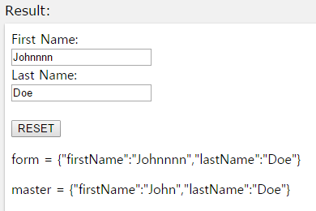
AngularJS Forms
Input, select, button, textarea 등의 요소 제어
<div ng-app="myApp" ng-controller="formCtrl"> <form novalidate> First Name:<br> <input type="text" ng-model="user.firstName"><br> Last Name:<br> <input type="text" ng-model="user.lastName"> <br><br> <button ng-click="reset()">RESET</button> </form> <p>form = {{user}}</p> <p>master = {{master}}</p> </div> <script> var app = angular.module('myApp', []); app.controller('formCtrl', function($scope) { $scope.master = {firstName: "John", lastName: "Doe"}; $scope.reset = function() { $scope.user = angular.copy($scope.master); }; $scope.reset(); }); </script>

Slide 20
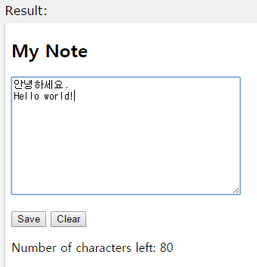
노트 어플리케이션
<!DOCTYPE html>
<html>
<script src=
"http://ajax.googleapis.com/ajax/libs/angularjs/1.3.14/angular.min.js"></script>
<body ng-app="myNoteApp" ng-controller="myNoteCtrl">
<h2>My Note</h2>
<textarea ng-model="message" cols="40" rows="10"></textarea>
<p>
<button ng-click="save()">Save</button>
<button ng-click="clear()">Clear</button>
</p>
<p>Number of characters left: <span ng-bind="left()"></span></p>
<script src="myNoteApp.js"></script>
<script src="myNoteCtrl.js"></script>
</body>
</html>
// myNoteApp.js 모듈
var app = angular.module("myNoteApp", []);
// myNoteCtrl.js 콘트롤러
app.controller("myNoteCtrl", function($scope) { $scope.message = ""; $scope.left = function() {return 100 - $scope.message.length;}; $scope.clear = function() {$scope.message = "";}; $scope.save = function() {alert("Note Saved");}; });

