Slide 1
13장. VPN
2012년 2학기
중부대학교 정보보호학과
이병천 교수

Slide 2
네트워크의 종류
공중망(Public Network)
가격이 저렴
네트워크를 공동으로 이용. 보안에 취약
사설망(Private Network)
공중망보다 가격이 비쌈
네트워크를 독립적으로 이용. 보안성이 우수
가상사설망(Virtual Private Network, VPN)
공중망에서 터널링 기술을 이용하여 사설망처럼 이용할 수 있도록 하는 기술
값싸게 보안통신을 이용할 수 있음

Slide 3
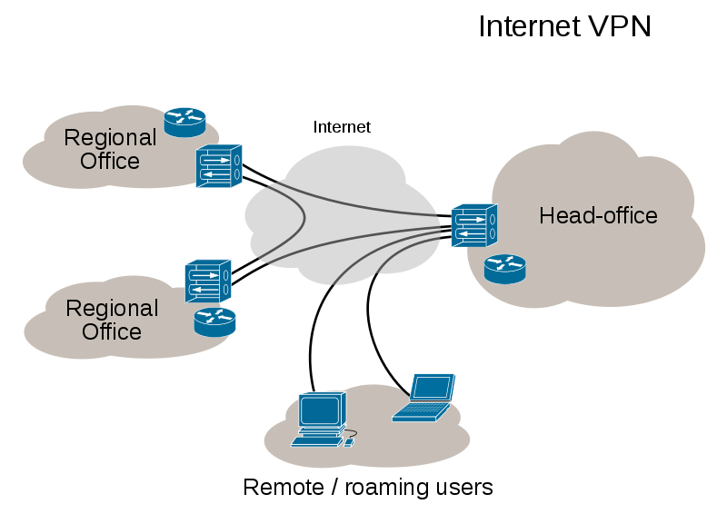
VPN의 응용
안전한 기업 업무환경 구축
본사-지사간의 안전한 네트워크 연결
재택근무: 집에서 회사 서버에 안전하게 접속 필요
VoIP 네트워크: 인터넷전화
IPTV, 비디오 회의

Slide 4
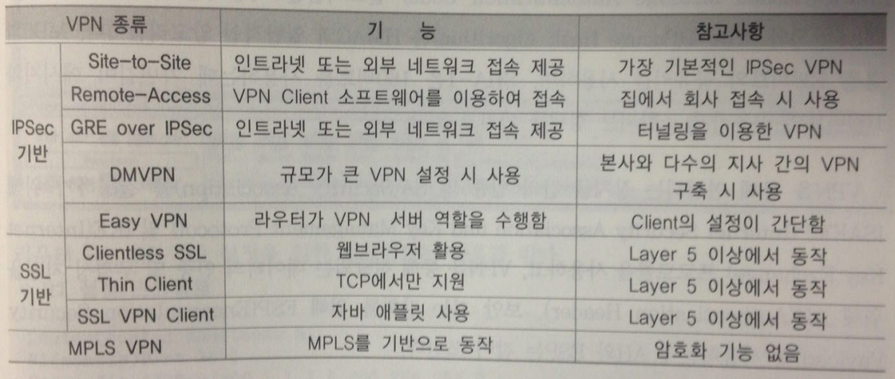
VPN의 종류
GRE(Generic Route Encapsulation)
DMVPN(Dynamic Multipoint VPN)
MPLS(multiprotocol label switching)
SSL(secure socket layer)

Slide 5
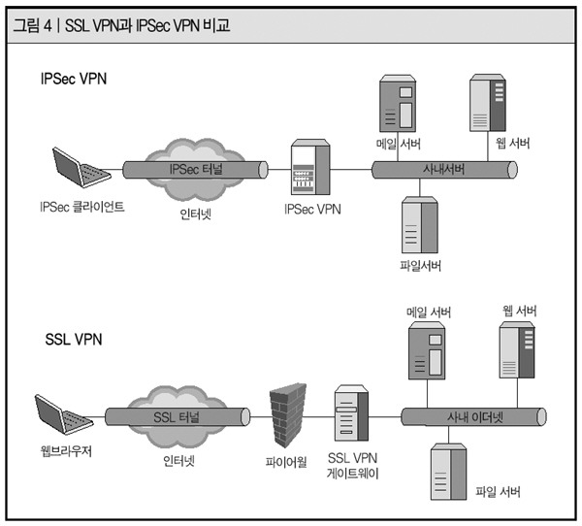
IPSec VPN vs. SSL VPN

Slide 6
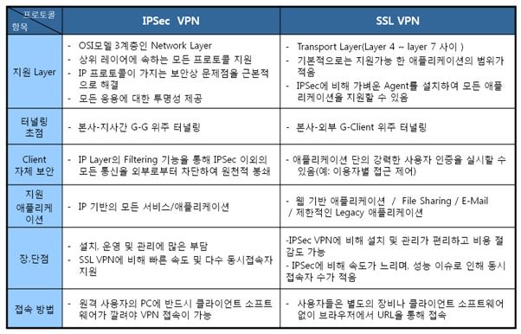
IPSec VPN vs. SSL VPN

Slide 7
VPN의 보안 기능
암호프로토콜 이용하여 인증, 보안, 기밀성 유지
키의 이용
대칭키 암호화 (Symmetric Encryption):
PSK(Pre-shared key) – 공유키 이용
디피-헬만(Diffie-Hellman) – 온라인 키합의 방식
비대칭키 암호화 (Asymmetric Encryption):
인증서 이용
암호 알고리즘
대칭키 암호: DES, 3DES, AES
비대칭키 암호: RSA
해쉬암고리즘: HMAC, MD5, SHA-1

Slide 8
VPN의 보안 기능
연결되는 장치간의 인증 및 보안연계(SA, security association) 프로토콜
ISAKMP (Internet security association and key management protocol)
IKE (Internet key exchange)
인증 및 암호화 프로토콜
AH(Authentication Header): 데이터의 인증 및 무결성
ESP(Encapsulation Security Payload): 데이터 암호화

Slide 9
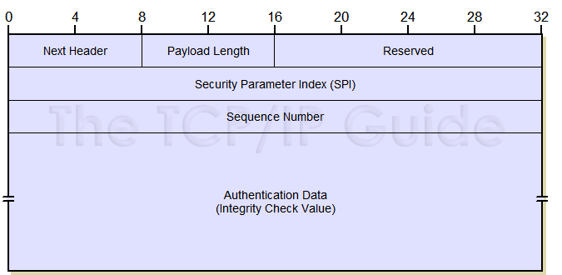
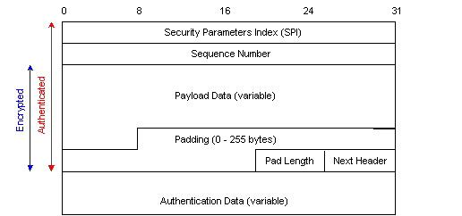
AH, ESP
ESP 헤더
AH 헤더

Slide 10
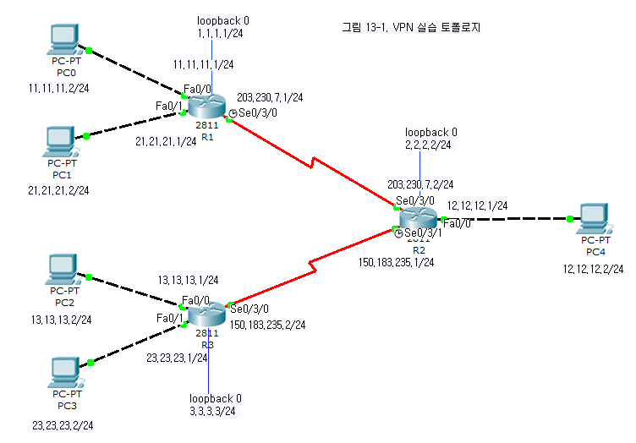
그림13-1. VPN 실습 토폴로지

Slide 11
라우터 설정
R2(config)#interface FastEthernet0/0
R2(config-if)#no shutdown
R2(config-if)#ip address 12.12.12.1 255.255.255.0
R2(config-if)#exit
R2(config)#interface Serial0/3/0
R2(config-if)#no shutdown
R2(config-if)#ip address 203.230.7.2 255.255.255.0
R2(config-if)#exit
R2(config)#interface Serial0/3/1
R2(config-if)#no shutdown
R2(config-if)#clock rate 1000000
R2(config-if)#ip address 150.183.235.1 255.255.255.0
R2(config-if)#exit
R2(config)#int lo 0
R2(config-if)#ip add 2.2.2.2 255.255.255.0
R2(config-if)#exit
R2(config)#router ospf 7
R2(config-router)#network 2.2.2.2 0.0.0.0 a 0
R2(config-router)#network 12.12.12.1 0.0.0.0 a 0
R2(config-router)#network 203.230.7.2 0.0.0.0 a 0
R2(config-router)#network 150.183.235.1 0.0.0.0 a 0
R1(config)#interface FastEthernet0/0
R1(config-if)#no shutdown
R1(config-if)#ip address 11.11.11.1 255.255.255.0
R1(config-if)#exit
R1(config)#interface FastEthernet0/1
R1(config-if)#no shutdown
R1(config-if)#ip address 21.21.21.1 255.255.255.0
R1(config-if)#exit
R1(config)#interface Serial0/3/0
R1(config-if)#no shutdown
R1(config-if)#clock rate 1000000
R1(config-if)#ip address 203.230.7.1 255.255.255.0
R1(config-if)#exit
R1(config)#int lo 0
R1(config-if)#ip add 1.1.1.1 255.255.255.0
R1(config-if)#exit
R1(config)#router ospf 7
R1(config-router)#network 1.1.1.1 0.0.0.0 a 0
R1(config-router)#network 11.11.11.1 0.0.0.0 a 0
R1(config-router)#network 21.21.21.1 0.0.0.0 a 0
R1(config-router)#network 203.230.7.1 0.0.0.0 a 0
R3(config)#interface FastEthernet0/0
R3(config-if)#no shutdown
R3(config-if)#ip address 13.13.13.1 255.255.255.0
R3(config-if)#exit
R3(config)#interface FastEthernet0/1
R3(config-if)#no shutdown
R3(config-if)#ip address 23.23.23.1 255.255.255.0
R3(config-if)#exit
R3(config)#interface Serial0/3/0
R3(config-if)#no shutdown
R3(config-if)#ip address 150.183.235.2 255.255.255.0
R3(config-if)#exit
R3(config)#int lo 0
R3(config-if)#ip add 3.3.3.3 255.255.255.0
R3(config-if)#exit
R3(config)#router ospf 7
R3(config-router)#network 3.3.3.3 0.0.0.0 a 0
R3(config-router)#network 13.13.13.1 0.0.0.0 a 0
R3(config-router)#network 23.23.23.1 0.0.0.0 a 0
R3(config-router)#network 150.183.235.2 0.0.0.0 a 0

Slide 12
라우팅 테이블 확인
R1#show ip route
1.0.0.0/24 is subnetted, 1 subnets
C 1.1.1.0 is directly connected, Loopback0
2.0.0.0/32 is subnetted, 1 subnets
O 2.2.2.2 [110/65] via 203.230.7.2, 16:22:43, Serial0/3/0
3.0.0.0/32 is subnetted, 1 subnets
O 3.3.3.3 [110/129] via 203.230.7.2, 00:11:12, Serial0/3/0
11.0.0.0/24 is subnetted, 1 subnets
C 11.11.11.0 is directly connected, FastEthernet0/0
12.0.0.0/24 is subnetted, 1 subnets
O 12.12.12.0 [110/65] via 203.230.7.2, 16:22:43, Serial0/3/0
13.0.0.0/24 is subnetted, 1 subnets
O 13.13.13.0 [110/129] via 203.230.7.2, 00:11:12, Serial0/3/0
21.0.0.0/24 is subnetted, 1 subnets
C 21.21.21.0 is directly connected, FastEthernet0/1
23.0.0.0/24 is subnetted, 1 subnets
O 23.23.23.0 [110/129] via 203.230.7.2, 00:11:12, Serial0/3/0
150.183.0.0/24 is subnetted, 1 subnets
O 150.183.235.0 [110/128] via 203.230.7.2, 00:13:17, Serial0/3/0
C 203.230.7.0/24 is directly connected, Serial0/3/0
R2#show ip route
1.0.0.0/32 is subnetted, 1 subnets
O 1.1.1.1 [110/65] via 203.230.7.1, 16:23:51, Serial0/3/0
2.0.0.0/24 is subnetted, 1 subnets
C 2.2.2.0 is directly connected, Loopback0
3.0.0.0/32 is subnetted, 1 subnets
O 3.3.3.3 [110/65] via 150.183.235.2, 00:12:24, Serial0/3/1
11.0.0.0/24 is subnetted, 1 subnets
O 11.11.11.0 [110/65] via 203.230.7.1, 16:23:51, Serial0/3/0
12.0.0.0/24 is subnetted, 1 subnets
C 12.12.12.0 is directly connected, FastEthernet0/0
13.0.0.0/24 is subnetted, 1 subnets
O 13.13.13.0 [110/65] via 150.183.235.2, 00:12:24, Serial0/3/1
21.0.0.0/24 is subnetted, 1 subnets
O 21.21.21.0 [110/65] via 203.230.7.1, 16:23:51, Serial0/3/0
23.0.0.0/24 is subnetted, 1 subnets
O 23.23.23.0 [110/65] via 150.183.235.2, 00:12:24, Serial0/3/1
150.183.0.0/24 is subnetted, 1 subnets
C 150.183.235.0 is directly connected, Serial0/3/1
C 203.230.7.0/24 is directly connected, Serial0/3/0
R3#show ip route
1.0.0.0/32 is subnetted, 1 subnets
O 1.1.1.1 [110/129] via 150.183.235.1, 00:13:57, Serial0/3/0
2.0.0.0/32 is subnetted, 1 subnets
O 2.2.2.2 [110/65] via 150.183.235.1, 00:13:57, Serial0/3/0
3.0.0.0/24 is subnetted, 1 subnets
C 3.3.3.0 is directly connected, Loopback0
11.0.0.0/24 is subnetted, 1 subnets
O 11.11.11.0 [110/129] via 150.183.235.1, 00:13:57, Serial0/3/0
12.0.0.0/24 is subnetted, 1 subnets
O 12.12.12.0 [110/65] via 150.183.235.1, 00:13:57, Serial0/3/0
13.0.0.0/24 is subnetted, 1 subnets
C 13.13.13.0 is directly connected, FastEthernet0/0
21.0.0.0/24 is subnetted, 1 subnets
O 21.21.21.0 [110/129] via 150.183.235.1, 00:13:57, Serial0/3/0
23.0.0.0/24 is subnetted, 1 subnets
C 23.23.23.0 is directly connected, FastEthernet0/1
150.183.0.0/24 is subnetted, 1 subnets
C 150.183.235.0 is directly connected, Serial0/3/0
O 203.230.7.0/24 [110/128] via 150.183.235.1, 00:13:57, Serial0/3/0

Slide 13
GRE 터널링
Tunnel 12
Tunnel 21
Tunnel 32
Tunnel 23
GRE(Generic Route Encapsulation)
- Cisco 에서 개발한 터널링 프로토콜

Slide 14
터널 설정 방법
R1(config)#int tunnel 12
터널 인터페이스 생성
R1(config-if)#ip add 163.180.116.1 255.255.255.0
터널 인터페이스의 IP주소 설정
R1(config-if)#tunnel source s0/3/0
터널은 가상 인터페이스를 사용하는데
실제 패킷이 전송될 물리적 인터페이스를 설정
R1(config-if)#tunnel destination 203.230.7.2
터널의 도착지 주소 설정
R1(config-if)#exit

Slide 15
터널 설정 방법
111.111.111.1/24
각 라우터에 터널링에 이용할
루프백 인터페이스 1번 추가
- 111.111.111.1/24
- 122.122.122.1/24
- 133.133.133.1/24
터널링 설정
- Tunnel 12: 163.180.116.1
- Tunnel 21: 163.180.116.2
- Tunnel 23: 163.180.117.1
- Tunnel 32: 163.180.117.2
터널간 RIPv2 를 이용해 라우팅 설정
163.180.116.1
122.122.122.1/24
163.180.116.2
163.180.117.1
163.180.117.2
133.133.133.1/24

Slide 16
터널 설정
R1(config)#int tunnel 12
R1(config-if)#ip add 163.180.116.1 255.255.255.0
R1(config-if)#tunnel source s0/3/0
R1(config-if)#tunnel destination 203.230.7.2
R1(config-if)#exit
터널 설정
R1(config)#int lo 1
R1(config-if)#ip add 111.111.111.1 255.255.255.0
R1(config-if)#exit
R1(config)#router rip
R1(config-router)#version 2
R1(config-router)#no auto-summary
R1(config-router)#network 111.111.111.1
R1(config-router)#network 163.180.116.1
R1(config-router)#exit
R2(config)#interface tunnel 21
R2(config-if)#ip add 163.180.116.2 255.255.255.0
R2(config-if)#tunnel source s0/3/0
R2(config-if)#tunnel destination 203.230.7.1
R2(config-if)#exit
R2(config-if)#interface tunnel 23
R2(config-if)#ip add 163.180.117.1 255.255.255.0
R2(config-if)#tunnel source s0/3/1
R2(config-if)#tunnel destination 150.183.235.2
R2(config-if)#exit
터널 설정
R3(config)#interface tunnel 32
R3(config-if)#ip add 163.180.117.2 255.255.255.0
R3(config-if)#tunnel source s0/3/0
R3(config-if)#tunnel destination 150.183.235.1
R3(config-if)#exit
R2(config)#int lo 1
R2(config-if)#ip add 122.122.122.1 255.255.255.0
R2(config-if)#exit
R2(config)#router rip
R2(config-router)#version 2
R2(config-router)#no auto-summary
R2(config-router)#network 122.122.122.1
R2(config-router)#network 163.180.116.2
R2(config-router)#network 163.180.117.1
R2(config-router)#exit
R3(config)#int lo 1
R3(config-if)#ip add 133.133.133.1 255.255.255.0
R3(config-if)#exit
R3(config)#router rip
R3(config-router)#version 2
R3(config-router)#no auto-summary
R3(config-router)#network 133.133.133.1
R3(config-router)#network 163.180.117.2
R3(config-router)#exit
Rip version 2 라우팅 설정

Slide 17
터널링 결과 – 라우팅테이블
R1#show ip route rip
122.0.0.0/24 is subnetted, 1 subnets
R 122.122.122.0 [120/1] via 163.180.116.2, 00:00:22, Tunnel12
133.133.0.0/24 is subnetted, 1 subnets
R 133.133.133.0 [120/2] via 163.180.116.2, 00:00:22, Tunnel12
163.180.0.0/24 is subnetted, 2 subnets
R 163.180.117.0 [120/1] via 163.180.116.2, 00:00:22, Tunnel12
R2#show ip route rip
111.0.0.0/24 is subnetted, 1 subnets
R 111.111.111.0 [120/1] via 163.180.116.1, 00:00:22, Tunnel21
133.133.0.0/24 is subnetted, 1 subnets
R 133.133.133.0 [120/1] via 163.180.117.2, 00:00:02, Tunnel23
R3#show ip route rip
111.0.0.0/24 is subnetted, 1 subnets
R 111.111.111.0 [120/2] via 163.180.117.1, 00:00:17, Tunnel32
122.0.0.0/24 is subnetted, 1 subnets
R 122.122.122.0 [120/1] via 163.180.117.1, 00:00:17, Tunnel32
163.180.0.0/24 is subnetted, 2 subnets
R 163.180.116.0 [120/1] via 163.180.117.1, 00:00:17, Tunnel32
OSPF – 물리적 인터페이스에 설정
RIP – 가상 터널인터페이스에 설정

Slide 18
터널링 결과 - Traceroute
R1#traceroute 13.13.13.2
Type escape sequence to abort.
Tracing the route to 13.13.13.2
1 203.230.7.2 9 msec 3 msec 4 msec
2 150.183.235.2 7 msec 11 msec 8 msec
3 13.13.13.2 16 msec 15 msec 15 msec
물리 인터페이스를
통해 연결
R1#traceroute 133.133.133.1
Type escape sequence to abort.
Tracing the route to 133.133.133.1
1 163.180.116.2 15 msec 1 msec 3 msec
2 163.180.117.2 9 msec 20 msec 4 msec
터널 인터페이스를
통해 연결

Slide 19
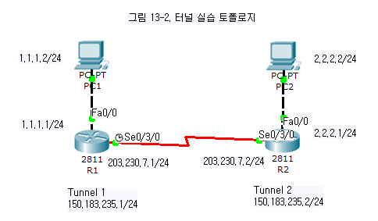
터널링을 통한 트래픽 분산과 제어
PC1과 PC2 사이의 통신은 터널을 통해 이루어지도록 설정

Slide 20
라우터 설정
R1(config)#interface FastEthernet0/0
R1(config-if)#no shutdown
R1(config-if)#ip address 1.1.1.1 255.255.255.0
R1(config-if)#exit
R1(config)#interface Serial0/3/0
R1(config-if)#no shutdown
R1(config-if)#clock rate 1000000
R1(config-if)#ip address 203.230.7.1 255.255.255.0
R1(config-if)#exit
R1(config)#router rip
R1(config-router)#version 2
R1(config-router)#network 1.1.1.0
R1(config-router)#network 203.230.7.0
R1(config-router)#network 150.183.235.0
R1(config-router)#exit
R1(config)#int tunnel 1
R1(config-if)#ip add 150.183.235.1 255.255.255.0
R1(config-if)#tunnel source s0/3/0
R1(config-if)#tunnel destination 203.230.7.2
R1(config-if)#exit
R1(config)#ip route 2.2.2.0 255.255.255.0 150.183.235.2
R2(config)#interface FastEthernet0/0
R2(config-if)#no shutdown
R2(config-if)#ip address 2.2.2.1 255.255.255.0
R2(config-if)#exit
R2(config)#interface Serial0/3/0
R2(config-if)#no shutdown
R2(config-if)#ip address 203.230.7.2 255.255.255.0
R2(config-if)#exit
R2(config)#router rip
R2(config-router)#version 2
R2(config-router)#network 2.2.2.0
R2(config-router)#network 203.230.7.0
R2(config-router)#network 150.183.235.0
R2(config-router)#exit
R2(config)#int tunnel 2
R2(config-if)#ip add 150.183.235.2 255.255.255.0
R2(config-if)#tunnel source s0/3/0
R2(config-if)#tunnel destination 203.230.7.1
R2(config-if)#exit
R2(config)#ip route 1.1.1.0 255.255.255.0 150.183.235.1

Slide 21
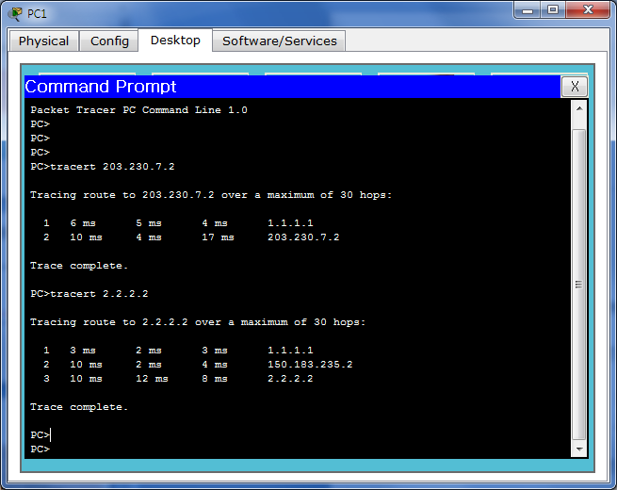
경로 확인
PC>tracert 203.230.7.2
Tracing route to 203.230.7.2 over a maximum of 30 hops:
1 6 ms 5 ms 4 ms 1.1.1.1
2 10 ms 4 ms 17 ms 203.230.7.2
Trace complete.
PC>tracert 2.2.2.2
Tracing route to 2.2.2.2 over a maximum of 30 hops:
1 3 ms 2 ms 3 ms 1.1.1.1
2 10 ms 2 ms 4 ms 150.183.235.2
3 10 ms 12 ms 8 ms 2.2.2.2
Trace complete.
목적지가 203.230.7.2인 경우에는 물리적인 인터페이스로 연결
목적지가 2.2.2.2인 경우에는 터널 인터페이스로 연결

Slide 22
GRE + IPSec VPN
GRE 터널링은 데이터 보안성이 없음
IPSec VPN을 GRE와 함께 사용하여 보안성 향상 가능
ISAKMP 정책
Authentication: pre-share
Encryption: AES 256
Hash: sha
Lifetime: 3600초
IPSec 정책
대상트래픽: 각 라우터의 시리얼 인터페이스를 통해 나가는 모든 트래픽
Encapsulation: ah-sha-hmac
Encryption: esp-aes 256
Hash: esp-sha-hmac

Slide 23
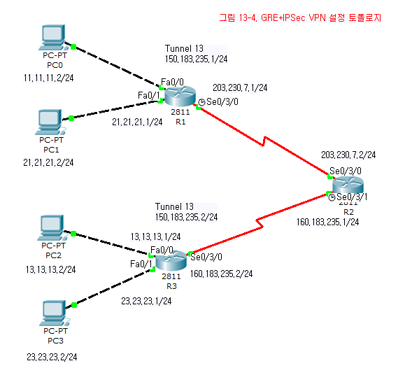
그림 13-4.

Slide 24
그림 13-4. 터널 설정
150.183.235.1
150.183.235.2
150.183.235.5
150.183.235.6

Slide 25
R1 설정
R1(config)#interface FastEthernet0/0
R1(config-if)#no shutdown
R1(config-if)#ip address 11.11.11.1 255.255.255.0
R1(config-if)#exit
R1(config)#interface FastEthernet0/1
R1(config-if)#no shutdown
R1(config-if)#ip address 21.21.21.1 255.255.255.0
R1(config-if)#exit
R1(config)#crypto isakmp policy 10
R1(config-isakmp)#encr aes 256
R1(config-isakmp)#authentication pre-share
R1(config-isakmp)#lifetime 3600
R1(config-isakmp)#hash sha
R1(config-isakmp)#exit
R1(config)#crypto ipsec transform-set strong esp-3des esp-md5-hmac
R1(config)#crypto isakmp key cisco123 address 0.0.0.0 0.0.0.0
R1(config)#crypto map vpn 10 ipsec-isakmp
R1(config-crypto-map)#set peer 203.230.7.2
R1(config-crypto-map)#set transform-set strong
R1(config-crypto-map)#match address 110
R1(config-crypto-map)#exit
R1(config)#int s0/3/0
R1(config-if)#ip add 203.230.7.1 255.255.255.0
R1(config-if)#clock rate 64000
R1(config-if)#crypto map vpn
R1(config-if)#no shutdown
R1(config-if)#exit
R1(config)#int tunnel 13
R1(config-if)#ip add 150.183.235.1 255.255.255.252
R1(config-if)#tunnel source s0/3/0
R1(config-if)#tunnel destination 203.230.7.2
R1(config-if)#exit
R1(config)#router ospf 7
R1(config-router)#network 150.183.0.0 0.0.255.255 a 0
R1(config-router)#network 11.11.11.1 0.0.0.0 a 0
R1(config-router)#network 21.21.21.1 0.0.0.0 a 0
R1(config-router)#network 203.230.7.1 0.0.0.0 a 0
R1(config-router)#exit
R1(config)#access-list 110 permit gre host 203.230.7.1 host 203.230.7.2
R1(config)#
VPN 동작을 선언
GRE 터널을 설정
ISAKMP 정책 선언
IPSec 정책 선언
정책이 적용될 범위를 ACL로 정의
ISAKMP 인증 암호 선언
어떤 트래픽에 대해 IPSec, ISAKMP를 적용할 것인지 선언

Slide 26
R2 설정
R2(config)#interface FastEthernet0/0
R2(config-if)#ip address 12.12.12.1 255.255.255.0
R2(config-if)#exit
R2(config)#crypto isakmp policy 10
R2(config-isakmp)#encr aes 256
R2(config-isakmp)#authentication pre-share
R2(config-isakmp)#lifetime 3600
R2(config-isakmp)#hash sha
R2(config-isakmp)#exit
R2(config)#crypto ipsec transform-set strong esp-3des esp-md5-hmac
R2(config)#crypto isakmp key cisco123 address 0.0.0.0 0.0.0.0
R2(config)#crypto map vpn 10 ipsec-isakmp
R2(config-crypto-map)#set peer 203.230.7.1
R2(config-crypto-map)#set transform-set strong
R2(config-crypto-map)#match address 110
R2(config-crypto-map)#exit
R2(config)#crypto map vpn 20 ipsec-isakmp
R2(config-crypto-map)#set peer 160.183.235.2
R2(config-crypto-map)#set transform-set strong
R2(config-crypto-map)#match address 120
R2(config-crypto-map)#exit
R2(config)#int s0/3/0
R2(config-if)#ip add 203.230.7.2 255.255.255.0
R2(config-if)#crypto map vpn
R2(config-if)#no shutdown
R2(config-if)#exit
R2(config)#int s0/3/1
R2(config-if)#ip add 160.183.235.1 255.255.255.0
R2(config-if)#clock rate 64000
R2(config-if)#crypto map vpn
R2(config-if)#no shutdown
R2(config-if)#exit
R2(config)#int tunnel 13
R2(config-if)#ip add 150.183.235.2 255.255.255.252
R2(config-if)#tunnel source s0/3/0
R2(config-if)#tunnel destination 203.230.7.1
R2(config-if)#exit
R2(config)#int tunnel 23
R2(config-if)#ip address 150.183.235.5 255.255.255.252
R2(config-if)#tunnel source s0/3/1
R2(config-if)#tunnel destination 160.183.235.2
R2(config-if)#exit
R2(config)#router ospf 7
R2(config-router)#network 150.183.0.0 0.0.255.255 a 0
R2(config-router)#network 203.230.7.2 0.0.0.0 a 0
R2(config-router)#network 160.183.235.1 0.0.0.0 a 0
R2(config-router)#exit
R2(config)#access-list 110 permit gre host 203.230.7.2 host 203.230.7.1
R2(config)#access-list 120 permit gre host 160.183.235.1 host 160.183.235.2

Slide 27
R3 설정
R3(config)#interface FastEthernet0/0
R3(config-if)#no shutdown
R3(config-if)#ip address 13.13.13.1 255.255.255.0
R3(config-if)#exit
R3(config)#interface FastEthernet0/1
R3(config-if)#no shutdown
R3(config-if)#ip address 23.23.23.1 255.255.255.0
R3(config-if)#exit
R3(config)#crypto isakmp policy 10
R3(config-isakmp)#encr aes 256
R3(config-isakmp)#authentication pre-share
R3(config-isakmp)#lifetime 3600
R3(config-isakmp)#hash sha
R3(config-isakmp)#exit
R3(config)#crypto ipsec transform-set strong esp-3des esp-md5-hmac
R3(config)#crypto isakmp key cisco123 address 0.0.0.0 0.0.0.0
R3(config)#crypto map vpn 20 ipsec-isakmp
R3(config-crypto-map)#set peer 160.183.235.1
R3(config-crypto-map)#set transform-set strong
R3(config-crypto-map)#match address 120
R3(config-crypto-map)#exit
R3(config)#crypto map vpn 10 ipsec-isakmp
R3(config-crypto-map)#set peer 203.230.7.1
R3(config-crypto-map)#set peer 160.183.235.1
R3(config-crypto-map)#set transform-set strong
R3(config-crypto-map)#match address 120
R3(config-crypto-map)#exit
R3(config)#int s0/3/0
R3(config-if)#ip add 160.183.235.2 255.255.255.0
R3(config-if)#crypto map vpn
R3(config-if)#no shutdown
R3(config-if)#exit
R3(config)#int tunnel 23
R3(config-if)#ip address 150.183.235.6 255.255.255.252
R3(config-if)#tunnel source s0/3/0
R3(config-if)#tunnel destination 160.183.235.1
R3(config-if)#exit
R3(config)#router ospf 7
R3(config-router)#network 150.183.0.0 0.0.255.255 a 0
R3(config-router)#network 13.13.13.1 0.0.0.0 a 0
R3(config-router)#network 23.23.23.1 0.0.0.0 a 0
R3(config-router)#network 160.183.235.2 0.0.0.0 a 0
R3(config-router)#exit
R3(config)#access-list 120 permit gre host 160.183.235.2 host 160.183.235.1

Slide 28
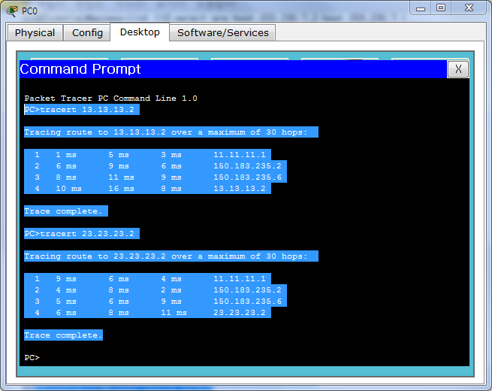
통신 경로 확인 - Tracert
11.11.11.2/24
VPN을 통해
연결됨을 확인

Slide 29
VPN 정보 확인하기
Show crypto ipsec sa
VPN이 적용된 인터페이스별로 VPN에 관한 모든 정보 확인
Show crypto ipsec transform-set
IPSec 설정이 올바로 적용되었는지 확인
Show crypto isakmp policy
ISAKMP 정책 확인
Show crypto isakmp sa
VPN의 출발지, 도착지, 현재 상태 확인
Show crypto map
VPN의 연결정보, ACL 확인

Slide 30
VPN 정보 – IPSec
R2#show crypto ipsec sa
interface: Serial0/3/0
Crypto map tag: vpn, local addr 203.230.7.2
protected vrf: (none)
local ident (addr/mask/prot/port): (203.230.7.2/255.255.255.255/47/0)
remote ident (addr/mask/prot/port): (203.230.7.1/255.255.255.255/47/0)
current_peer 203.230.7.1 port 500
PERMIT, flags={origin_is_acl,}
#pkts encaps: 339, #pkts encrypt: 339, #pkts digest: 0
#pkts decaps: 333, #pkts decrypt: 333, #pkts verify: 0
#pkts compressed: 0, #pkts decompressed: 0
#pkts not compressed: 0, #pkts compr. failed: 0
#pkts not decompressed: 0, #pkts decompress failed: 0
#send errors 0, #recv errors 0
local crypto endpt.: 203.230.7.2, remote crypto endpt.:203.230.7.1
path mtu 1500, ip mtu 1500, ip mtu idb Serial0/3/0
current outbound spi: 0x71A90ABA(1906903738)
inbound esp sas:
spi: 0x0EA95861(245979233)
--More--

Slide 31
VPN 정보 - ISAKMP
R2#show crypto isakmp policy
Global IKE policy
Protection suite of priority 10
encryption algorithm: AES - Advanced Encryption Standard (256 bit keys).
hash algorithm: Secure Hash Standard
authentication method: Pre-Shared Key
Diffie-Hellman group: #1 (768 bit)
lifetime: 3600 seconds, no volume limit
Default protection suite
encryption algorithm: DES - Data Encryption Standard (56 bit keys).
hash algorithm: Secure Hash Standard
authentication method: Rivest-Shamir-Adleman Signature
Diffie-Hellman group: #1 (768 bit)
lifetime: 86400 seconds, no volume limit
R2#show crypto isakmp sa
IPv4 Crypto ISAKMP SA
dst src state conn-id slot status
203.230.7.1 203.230.7.2 QM_IDLE 1075 0 ACTIVE (deleted)
160.183.235.2 160.183.235.1 QM_IDLE 1089 0 ACTIVE (deleted)
IPv6 Crypto ISAKMP SA

Slide 32
VPN 정보 – map
R2#show crypto map
Crypto Map vpn 10 ipsec-isakmp
Peer = 203.230.7.1
Extended IP access list 110
access-list 110 permit gre host 203.230.7.2 host 203.230.7.1
Current peer: 203.230.7.1
Security association lifetime: 4608000 kilobytes/3600 seconds
PFS (Y/N): N
Transform sets={
strong,
}
Interfaces using crypto map vpn:
Serial0/3/0
Serial0/3/1
Crypto Map vpn 20 ipsec-isakmp
Peer = 160.183.235.2
Extended IP access list 120
access-list 120 permit gre host 160.183.235.1 host 160.183.235.2
Current peer: 160.183.235.2
Security association lifetime: 4608000 kilobytes/3600 seconds
PFS (Y/N): N
Transform sets={
strong,
}
Interfaces using crypto map vpn:
Serial0/3/0
Serial0/3/1

Slide 33
13장 실습과제
실습1. GRE 터널링 실습 (그림 13-1)
실습2. 터널링을 통한 트래픽 분산과 제어 (그림 13-2)
실습3. GRE+IPSec VPN (그림 13-4)

Slide 34
13장 실습과제
실습 4. 윈도우7에서의 VPN 연결 실습
VPN 서버
VPN 클라이언트
제어판->
네트워크 및 인터넷->
네트워크 및 공유센터->
어댑터 설정 변경->
Alt -> 파일 ->
새로 들어오는 연결->
사용자 계정 선택 ->
인터넷을 통해->
엑세스 허용
Ipconfig 로 ppp 연결 확인
제어판->
네트워크 및 인터넷->
네트워크 및 공유센터->
새 연결 또는 네트워크 설정->
회사에 연결->
새 연결을 만듭니다->
내 인터넷 연결 사용->
인터넷 주소 입력->
VPN 연결->
사용자 이름, 암호 입력
Ipconfig 로 ppp 연결 확인

Slide 35
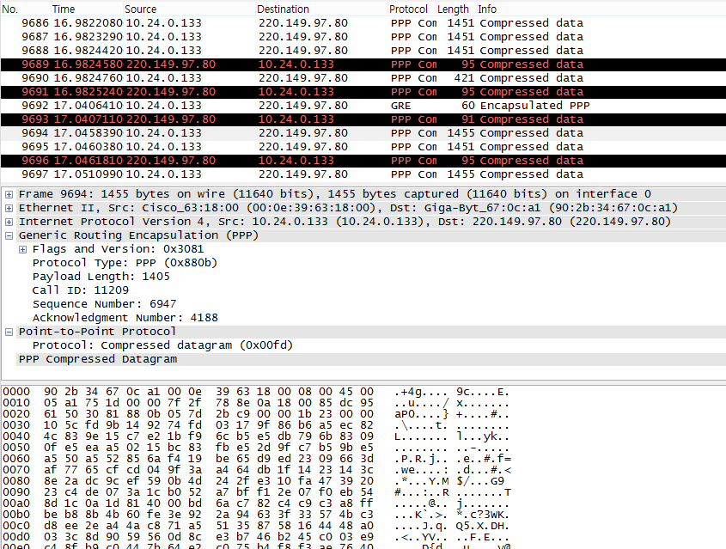
13장 실습과제
연결 후 wireshark를 이용한 패킷 분석
VPN 연결을 이용하는 통신은 보안통신 ppp로 연결됨

